Slide 1
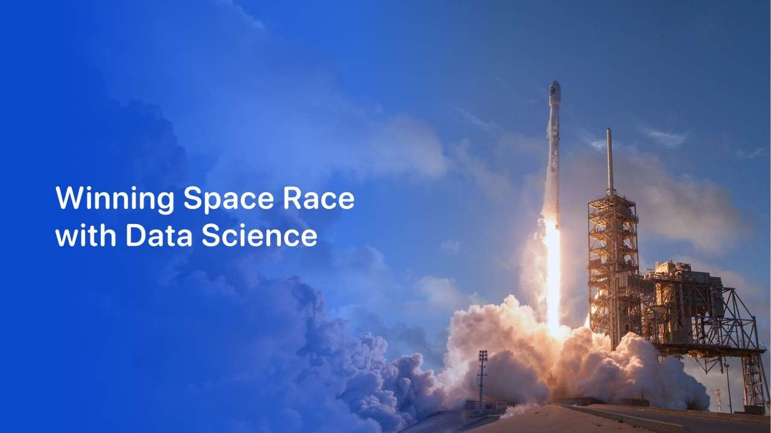

PAVITHRAN. S. N
30 DEC 2023

Slide 2
Outline
2
Executive Summary
Introduction
Methodology
Results
Conclusion

Slide 3
Executive Summary
3
• Summary of methodologies:
• Data Collection using Web scraping and REST API queries
• Data Wrangling to Classify Launches based on Success and transform data into standardized numeric form
• Exploratory Data Analysis using SQL and Visualization packages for Python
• Interactive Plotly Web App to visualize payload and success launch data at each Launch Site
• Exploring Launch Sites using interactive Folium Maps
• Predictive analysis for classification of Rocket Landing Success
• Summary of all results:
• Exploratory Data Analysis Results
• Predictive Analysis Results

Slide 4
Introduction
4
SpaceX advertises Falcon 9 rocket launches on its website, with a cost of 62
million dollars; other providers cost upward of 165 million dollars each, much
of the savings is because SpaceX can reuse the first stage. Therefore if we can
determine if the first stage will land, we can determine the cost of a launch.
This information can be used if an alternate company wants to bid against
SpaceX for a rocket launch. Thus it is advantageous to be able to predict
whether the Falcon 9 first stage will land successfully for new missions.
To make valuable predictions we must solve the following:
• What factors of a mission influence Falcon 9 launch success?
• What conditions must be met by SpaceX to ensure the highest probability of
success for a given mission?

Slide 5

Section 1
5

Slide 6
Methodology
6
Executive Summary
Data collection methodology:
Using Space X API and web scraping from wikipedia.
Perform data wrangling
Clean the data
Perform exploratory data analysis (EDA) using visualization and SQL
Perform interactive visual analytics using Folium and Plotly Dash
Perform predictive analysis using classification models
Creating various Machine learning models and validate by score.

Slide 7





Data Collection
7
The Data sets are collected by
SpaceX API request.
Web Scraping
Enter the URL of the page you want to analyze for this project
Request and parse the SpaceX launch data using the GET request
decode the response content as a JSON and
turn it into a Pandas data frame
now use the API again to get information about the launches using the IDs given for each launch
Filter the data frame to only include Falcon 9 launches and replace
null values and get required output

Slide 8









Data Collection – SpaceX API
8
Steps
Request data from SpaceX API (rocket launch data)
Decode response using .json() and convert to a dataframe using .json_normalize()
Request information about the launches from SpaceX API using custom functions
Create dictionary from the data
Create dataframe from the dictionary
Filter dataframe to contain only Falcon 9 launches
Replace missing values of Payload Mass with calculated .mean()
Export data to csv file
Make request to SpaceX API
Decode the response content as a JSON
Turn JSON into pandas data frame
Use the API again to get information about the launches using the IDs given for each launch
Construct our dataset using the data we have obtained
https://github.com/imyoungman/Applied-Data-Science-Capstone-Falcon9-Spacex/blob/2034e694be52116d3a04652a0f0dd0c3ddcd94f2/1_jupyter-labs-spacex-data-collection-api.ipynb

Slide 9





Data Collection - Web Scraping
9
Falcon9 Launch Wiki page from its URL
Steps
Request data (Falcon 9 launch data) from Wikipedia
Create BeautifulSoup object from HTML response
Extract column names from HTML table header
Collect data from parsing HTML tables
Create dictionary from the data
Create dataframe from the dictionary
Export data to csv file
Create a Beautiful Soup object from the HTML
Extract all column names from the HTML table
Create an empty dictionary with keys from the column names
Fill up the dictionary with launch records extracted from table rows.
Convert the dictionary into a CSV dataset
https://github.com/imyoungman/Applied-Data-Science-Capstone-Falcon9-Spacex/blob/2034e694be52116d3a04652a0f0dd0c3ddcd94f2/2_jupyter-labs-webscraping.ipynb

Slide 10







Data Wrangling
10
Data Wrangling process is given in a flow chart for a over view.
steps
Perform EDA and determine
data labels
Calculate:
# of launches for each site
# and occurrence of orbit
# and occurrence of mission outcome per orbit type]
Create binary landing outcome column (dependent variable)
Export data to csv file
Calculate the number of launches on each site
Calculate the number and occurrences of each orbit
Calculate the number and occurence of mission outcome per orbit type
Create a landing outcome label from Outcome column
https://github.com/imyoungman/Applied-Data-Science-Capstone-Falcon9-Spacex/blob/2034e694be52116d3a04652a0f0dd0c3ddcd94f2/3_labs-jupyter-spacex-Data wrangling.ipynb

Slide 11
EDA with Data Visualization
11
Types of Charts Used :
scatter plot - Flight Number vs Payload Mass , Flight Number vs Launch Sites , Payload and Launch Sites , Flight Number and Orbit Type , Payload and Orbit Type
Bar chart – Success rate of each orbit
Line plot – success rate and Date
https://github.com/imyoungman/Applied-Data-Science-Capstone-Falcon9-Spacex/blob/2034e694be52116d3a04652a0f0dd0c3ddcd94f2/5_jupyter-labs-eda-dataviz.ipynb.jupyterlite.ipynb

Slide 12
EDA with SQL
12
Summary of SQL queries that were used:
Display the names of the unique launch sites in the space mission
Display 5 records where launch sites begin with the string ‘CCA
Display the total payload mass carried by boosters launched by NASA (CRS)
Display average payload mass carried by booster version F9 v1.1
List the date when the first successful landing outcome in ground pad was acheived
List the names of the boosters which have success in drone ship and have payload mass greater than 4000 but less than 6000
List the total number of successful and failure mission outcomes
List the names of the booster versions which have carried the maximum payload mass. Use a subquery
List the failed landing outcomes in drone ship, their booster versions, and launch site names for in year 2015
Rank the count of landing outcomes (such as Failure (drone ship) or Success (ground pad)) between the date 2010-06-04 and 2017-03-20, in descending order
https://github.com/imyoungman/Applied-Data-Science-Capstone-Falcon9-Spacex/blob/2034e694be52116d3a04652a0f0dd0c3ddcd94f2/4_jupyter-labs-eda-sql-coursera_sqllite.ipynb

Slide 13


Build an Interactive Map with Folium
13
Folium Markers were used to show the Space X launch sites and their nearest important landmarks like railways, highways, cities and coastlines.
Polylines were used to connect the launch sites to their nearest land marks.
Red represents rocket launch Failures
Green represents the successes.
https://github.com/imyoungman/Applied-Data-Science-Capstone-Falcon9-Spacex/blob/2034e694be52116d3a04652a0f0dd0c3ddcd94f2/6_lab_jupyter_launch_site_location.jupyterlite.ipynb

Slide 14


Build a Dashboard with Plotly Dash
14
Pie charts and scatter charts were used to visualize the launch records of Space X.
These charts displayed the rocket launch success rate per launch site. We are were able to get an understanding of the factors that may have been influencing the success rate at each site. Such as the payload mass and booster versions.
Successful launches were represented by 1 while failures were represented by 0.
https://github.com/imyoungman/Applied-Data-Science-Capstone-Falcon9-Spacex/blob/2034e694be52116d3a04652a0f0dd0c3ddcd94f2/7_spacex_dash_app.py

Slide 15







Predictive Analysis (Classification)
15
Scikit-learn is Machine Learning library that was used for predictive analysis. The following took place:
Created a machine learning pipeline to predict if the first stage will land given the data.
Create a column for the class
Split data into training data and test data
Standardize the data
Calculate the accuracy on the test data
Create a Grid SearchCV object and fit different ML objects.
Choose the best ML method
Compare the predictions with the real labels
https://github.com/imyoungman/Applied-Data-Science-Capstone-Falcon9-Spacex/blob/2034e694be52116d3a04652a0f0dd0c3ddcd94f2/8_SpaceX_Machine_Learning_Prediction_Part_5.jupyterlite.ipynb

Slide 16
Results
16
The exploratory data analysis has shown us that successful landing outcomes are somewhat correlated with flight number. It was also apparent that successful landing outcomes have had a significant increase since the year 2015.
All launch sites are located near the coast line. Perhaps, this makes it easier to test rocket landings in the water.
sites are also located near highways and railways. This may facilitate transportation of equipment and research material.
The machine learning were able to predict the landing success of rockets with an accuracy score of 83.33%.

Slide 17

Section 2

Slide 18

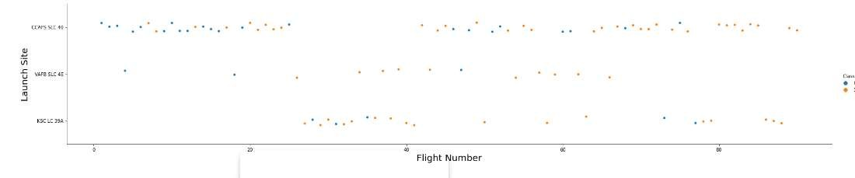
Flight Number vs. Launch Site
18
It appears that there were more successful landings as the flight numbers increased. launch site CCAFS SLC 40 had the most number of landing.

Slide 19

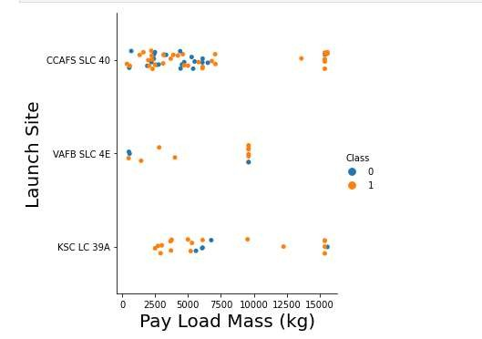
Payload vs. Launch Site
19
Now if you observe the scatter point chart, you will find for the VAFB-SLC launch site there are no rockets launched for heavy payload mass(greater than 10000).

Slide 20

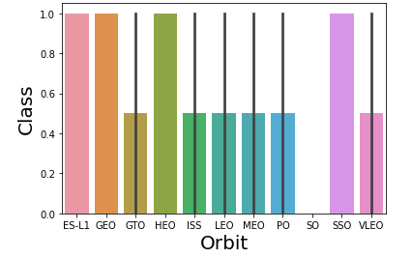
Success Rate vs. Orbit Type
20
The highest success rate ORBITS are
ES-L1 GEO SSO HEO

Slide 21

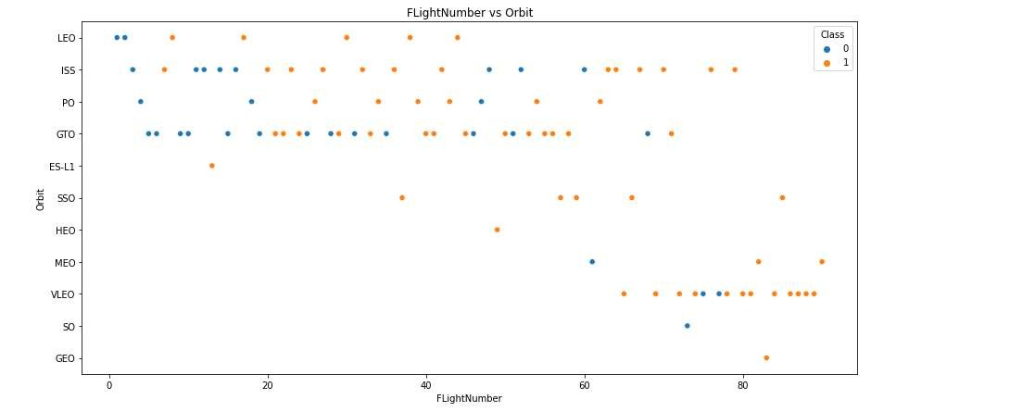
Flight Number vs. Orbit Type
21
You can see that in the LEO orbit the Success appears related to the number of flights; on the other hand, there seems to be no relationship between flight number when in GTO orbit.

Slide 22

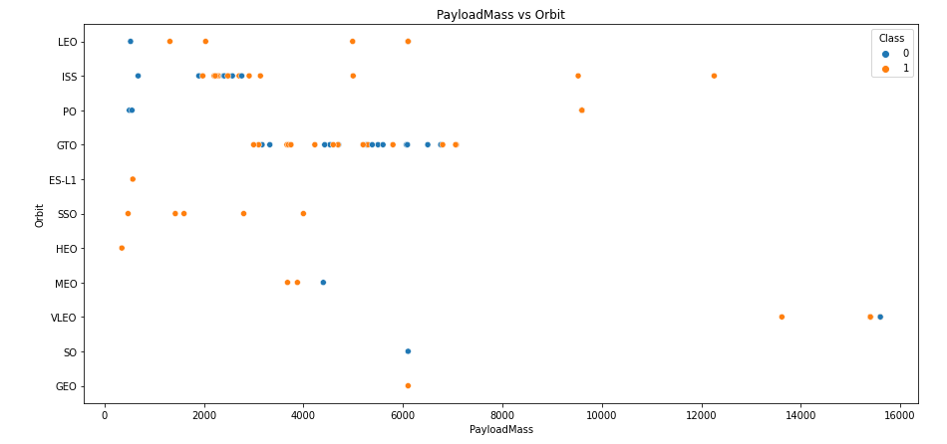
Payload vs. Orbit Type
22
With heavy payloads the successful landing or positive landing rate are more for Polar, LEO and ISS.
However for GTO we cannot distinguish this well as both positive landing rate and negative
landing(unsuccessful mission) are both there.

Slide 23

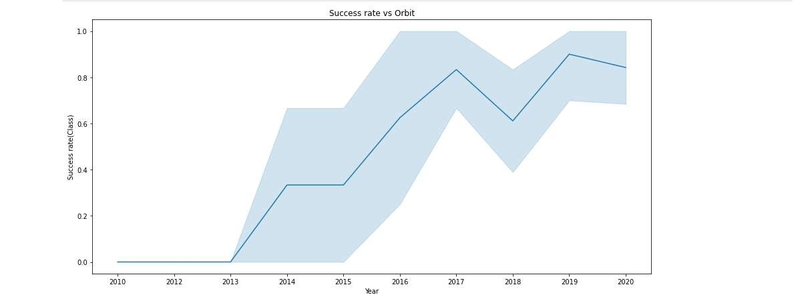
Launch Success Yearly Trend
23
It is apparent that the success rate has significantly increased from 2013 to 2020.

Slide 24
All Launch Site Names
24
Given the data, these are the names of the launch sites where different rocket landings where attempted:
CCAFS LC-40
CCAFS SLC-40
KSC LC-39A
VAFB SLC-4E

Slide 25

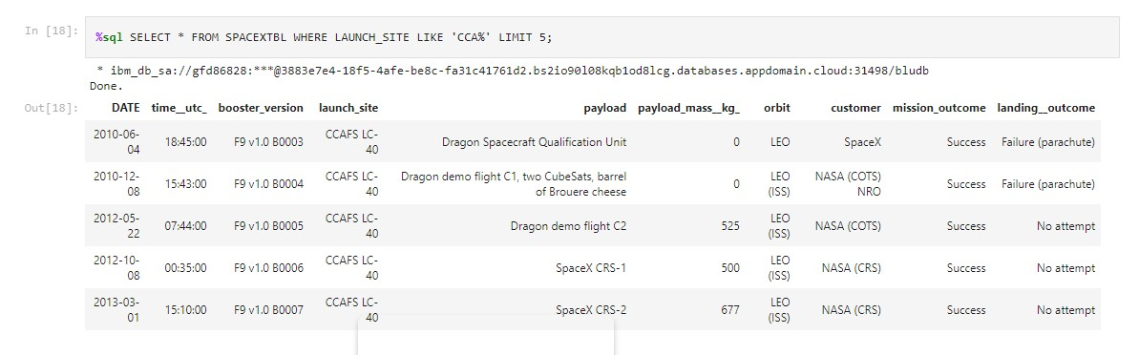
Launch Site Names Beginning with 'CCA'
25
These are 5 records where launch sites begin with the letters 'CCA'. As we can see, there are other organizations besides Space X that were testing their rockets.

Slide 26
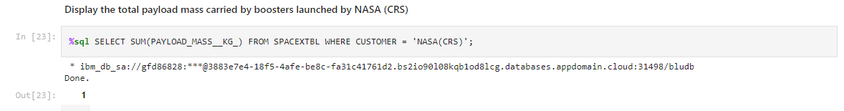
Total Payload Mass
26
The information in the picture displays the total payload mass carried by boosters launched by NASA

Slide 27
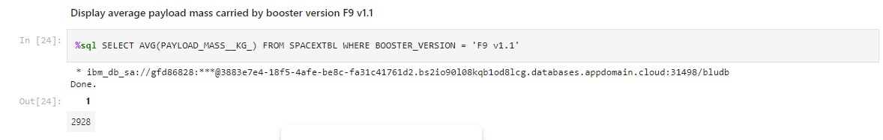
Average Payload Mass by F9 v1.1
27
The average payload mass carried by F9 v1.1 was 2928.4 kg.

Slide 28

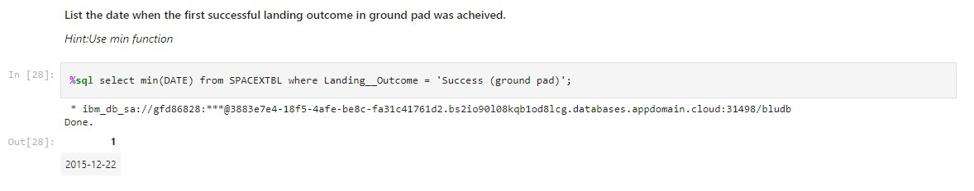
First Successful Ground Landing Date
28
From the picture given above you can see that the first successful ground pad was in 22 December 2015.

Slide 29

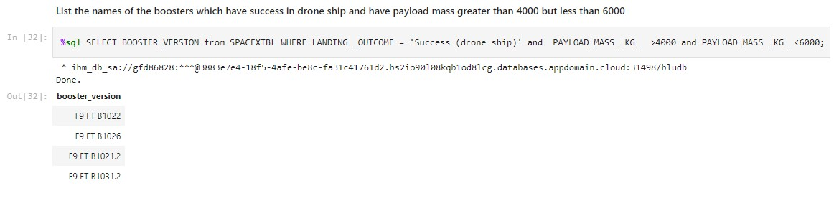
Successful Drone Ship Landing with Payload between 4000 and 6000
29
It appears that there only 4 Boosters with a payload mass between 4000 and 6000 they are
F9 FT B1022
F9 FT B1026
F9 FT B1021.2
F9 FT B1031.2

Slide 30

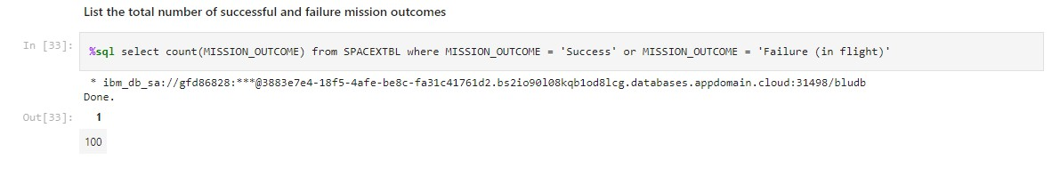
Total Number of Successful and Failure Mission Outcomes
30
The Above picture show the total number of successful and failure mission outcomes

Slide 31

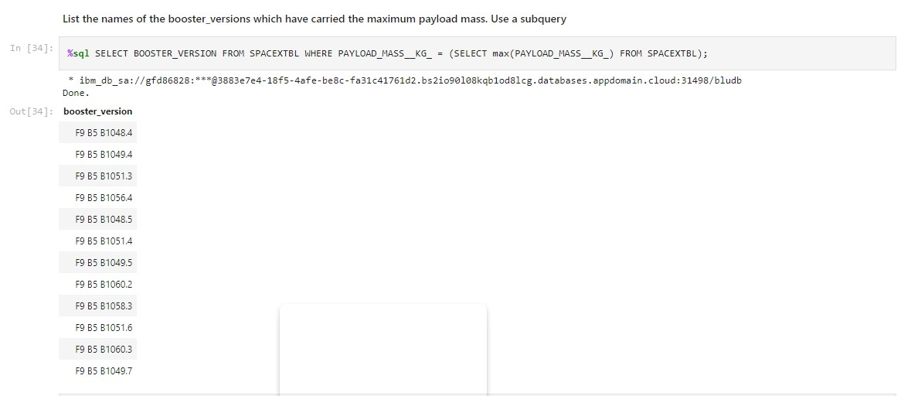
Boosters That Carried the Maximum Payload Mass
31
From the above picture it shows that 12 boosters have carried the maximum payload mass of 15600 kg.

Slide 32

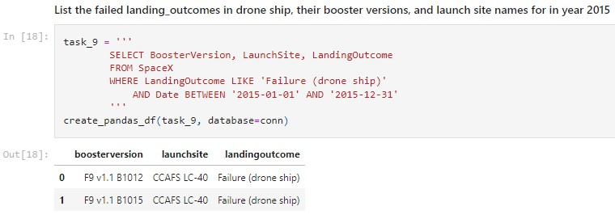
2015 Launch Records - Failed Landing Outcomes
32
2 boosters F9 v1.1B1012_CCAFS LC-40 and
F9v1.1B1015 CCAFS LC-40
failed to land at 2015

Slide 33

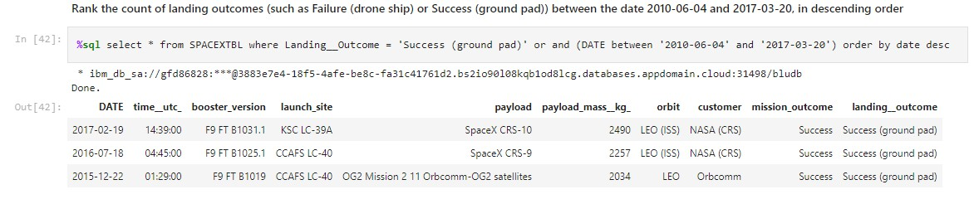
Rank Landing Outcomes Between 2010-06-04 and 2017-03-20
33
The number of successful landings have increased since 2015.

Slide 34

Section 3

Slide 35
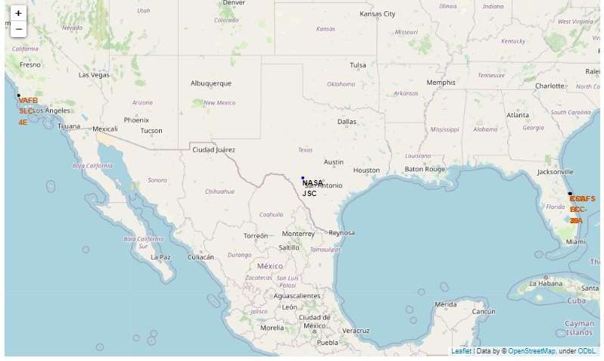
Launch Site Locations
35
all launch sites are in very close proximity to the coast and they are also a couple thousand kilometers away from the equator line.

Slide 36
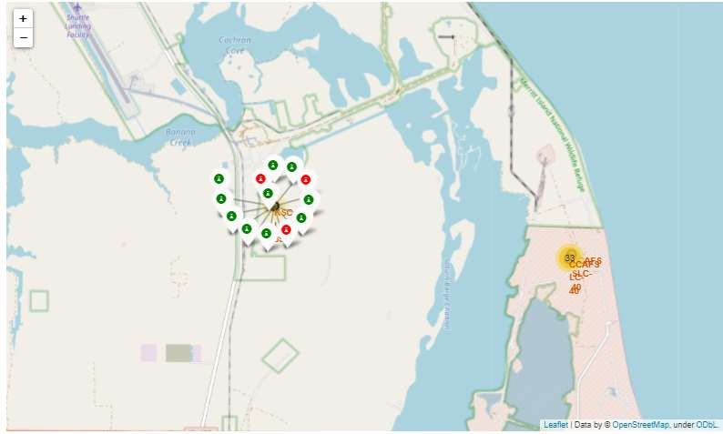
Success Rate of Rocket Launches
36
The successful launches are represented by a green marker while the red marker represents failed rocket launches.

Slide 37
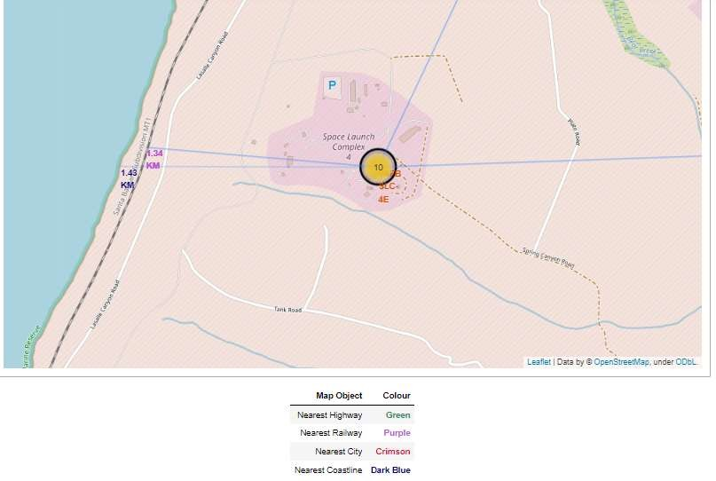
Surrounding Landmarks
37
It appears that launch sites are usually set up at least 18 km away from cities. This may be because of the desire to prevent any crashes near populated areas.
It is also apparent that launch sites are in very close proximity to railways and highways. Perhaps, due to the necessary transportation requirements for rocket parts.
The sites are close the coast line. This is evident with the many rocket landing tests on water bodies like the ocean.

Slide 38

Section 4

Slide 39

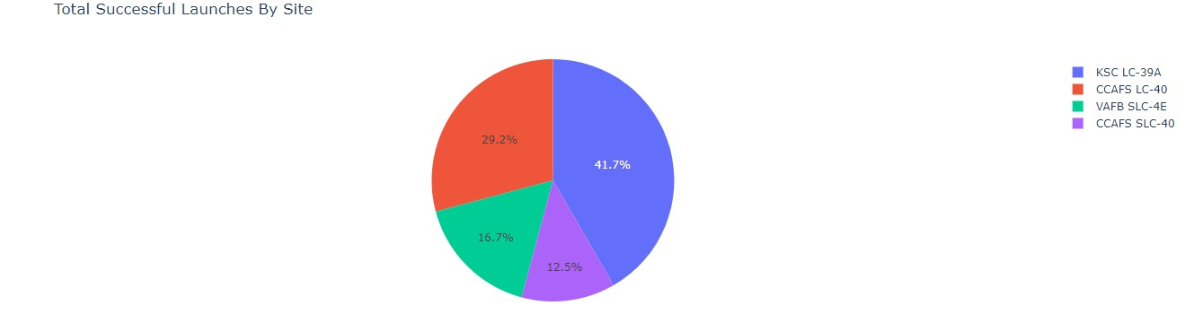



Successful Launches by Site
39
You can see from the plot that Site KSC LC-39A has the largest successful launches as well the highest launch success rate.

Slide 40

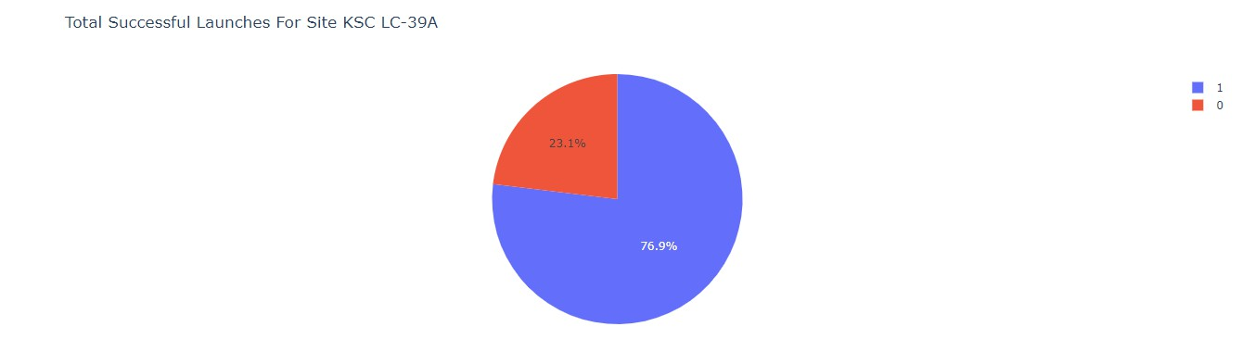



Total Successful Launches for Site KSC LC-39A
40
You can see that 76.9% of the total launches at site KSC LC-39A were successful. This is a the highest success rate of all the different launch sites.

Slide 41

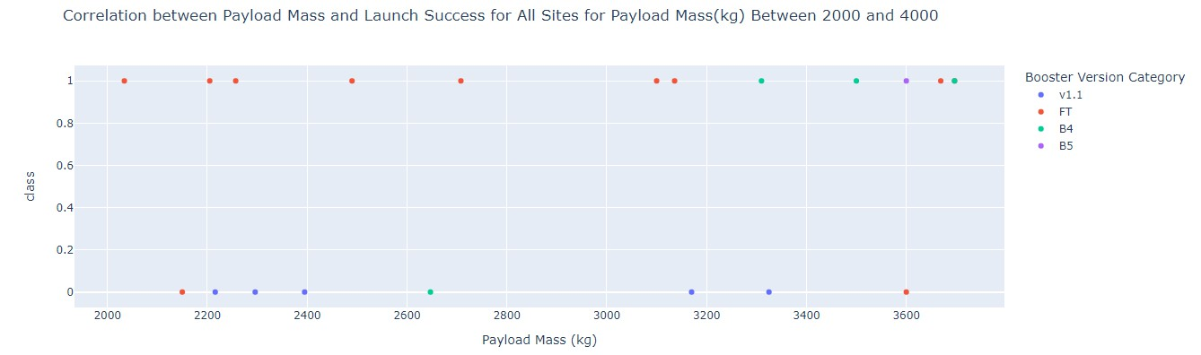
Payload Mass vs. Launch Success for All Sites
41
It appears that the payload range between 2000 kg and 4000 kg has the highest success rate.

Slide 42

Section 5

Slide 43

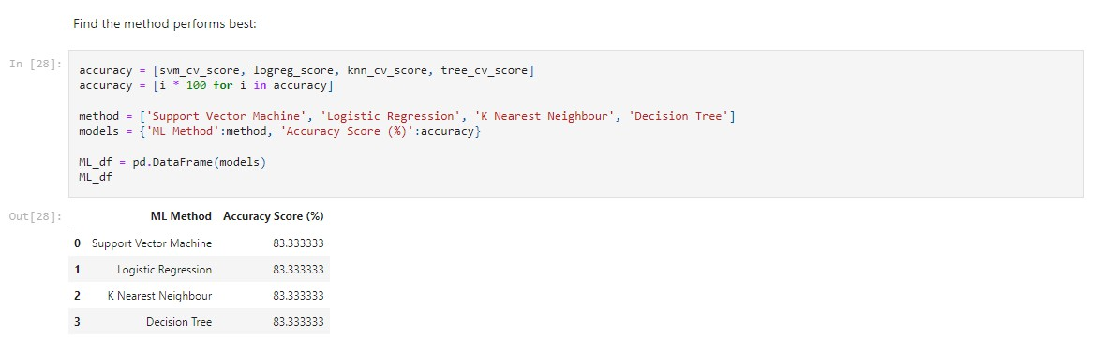
Classification Accuracy
43
You can see that All the methods have an identical accuracy score of 83.33%, so we decided to use Logistic Regression for the classification

Slide 44
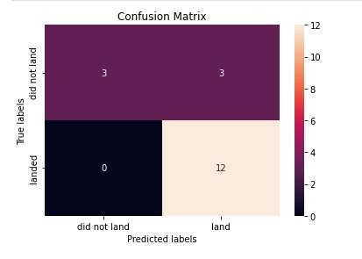
Confusion Matrix
44
The chart shows the confusion matrix of the Logistic Regression model that was chosen.
The model only failed to accurately predict 3 labels.

Slide 45


Conclusions
45
In order to compete with Space X Through this process, a general picture of their success methods are
All their launch sites are located near the coast, away from nearby cities. This enabled to them to test
their rocket landings without much interference.
Site KSC LC-39A had the highest launch success rate out of all the launch sites.
From 2015 onwards, the success rate of rocket landings significantly increased. It was also apparent that landing success increased with flight number
All this data was used to train a machine learning model that is able to predict the landing outcome of rocket launches with 83.33% accuracy.

Slide 46
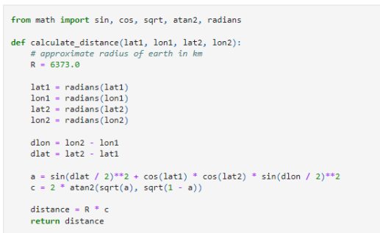
Appendix
45
Haversine's Formula used to calculate distances on Folium Maps

Slide 47
Insights
45
Things to Consider
• Dataset: A larger dataset will help build on the predictive analytics results to help understand if the findings can be generalizable to a larger data set
• Feature Analysis / PCA: Additional feature analysis or principal component
analysis should be conducted to see if it can help improve accuracy
• XGBoost: Is a powerful model which was not utilized in this study. It would
be interesting to see if it outperforms the other classification models

Slide 48


